Slide 1


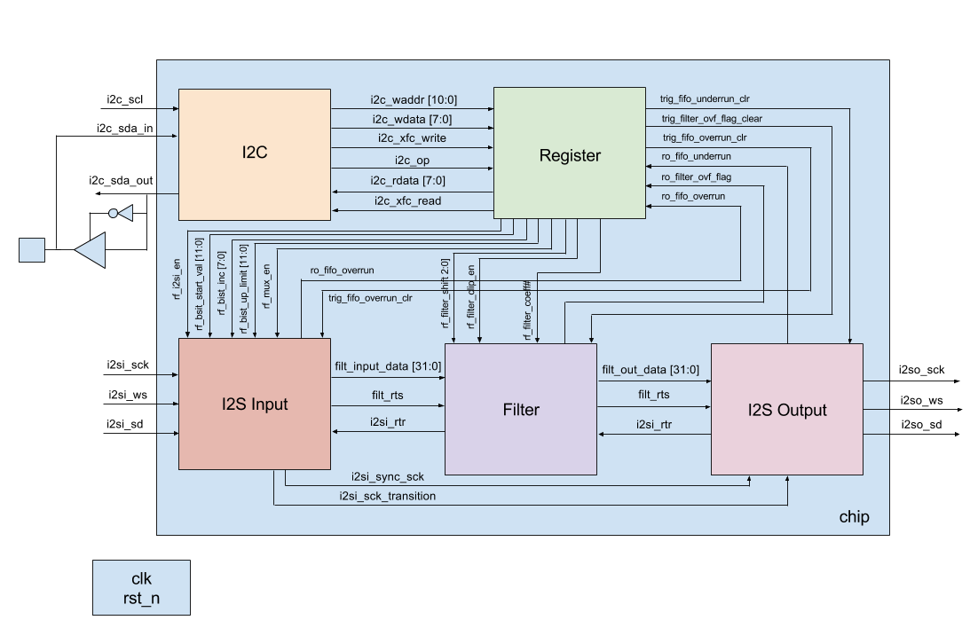
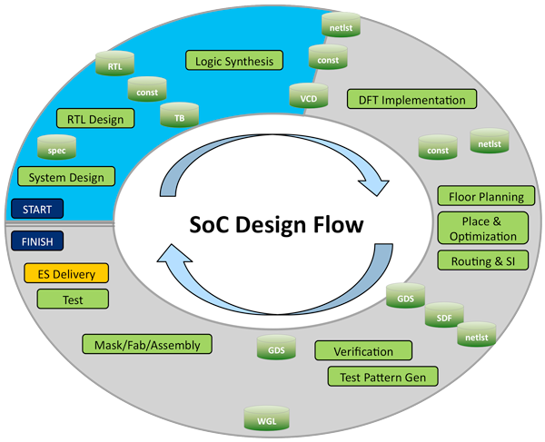
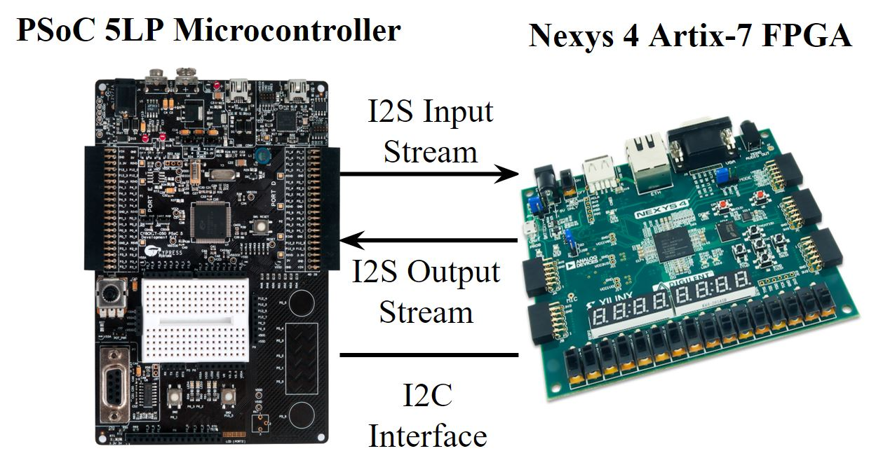
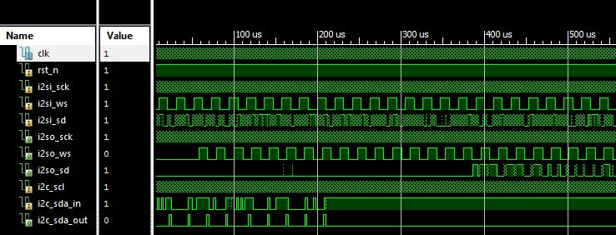
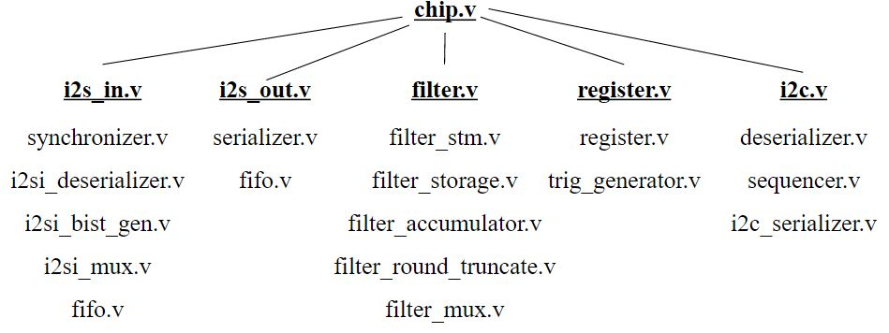
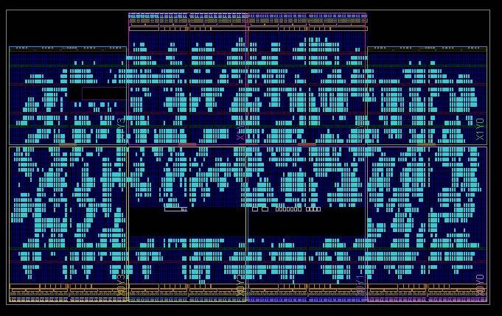
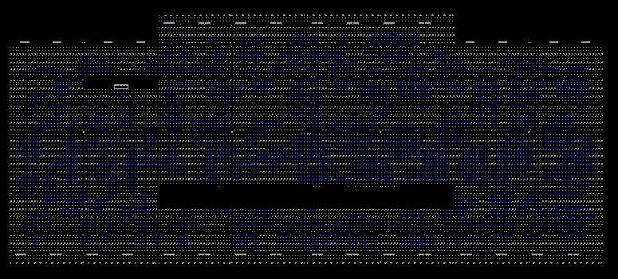
Design and Verification of an ASIC
Kevin Cao, Whitley Forman, Dhruvit Naik, Zachary Nelson and Julie Swift
Advisors: Dr. Orlando Hernandez and Dr. Larry Pearlstein
Department of Electrical and Computer Engineering, The College of New Jersey, Ewing, NJ
Abstract
The goal of this project is to gain experience in VLSI design by designing a chip that will process digital streaming audio data. More specifically, we will implement a 512-tap digital finite impulse response (FIR) filter, which will be applied to an input stream in order to create an output stream. We used the I2C protocol to allow a host to control the chip and the serial I2S protocol for transferring digital audio streams.
Our hardware design was represented using Verilog register-transfer level (RTL) code. Development has been done using Xilinx ISE Design Suite 14.7. Test benches were also designed and implemented using Verilog. The RTL design has been completed and tested. However, additional synthesis and verification still needs to be completed. The end goal of the project is to implement the design on a field-programmable gate array (FPGA) for testing. We will bring up our FPGA design with a realistic environment including an audio source, audio sink, and a microcontroller for reading and writing registers. We also plan to send a simple circuit for fabrication by MOSIS that will help us gain experience in physical chip design and prepare future groups to fabricate our full design.
Design/Methods
Figure 1- Chip Design Process
Figure 2 – Top-Level Schematic
Figure 3 – Realistic FPGA Environment
Introduction
Our chip will be produced by MOSIS, at no cost to The College of New Jersey.
MOSIS stands for Metal Oxide Semiconductor Implementation Service and the company has produced over 60,000 IC designs over the last 30 years [1].
The MOSIS Service is known for Multiple Project Wafers (MPWs), which is how they are able to keep the cost of fabrication low.
We are registered for a MOSIS Educational Program (MEP) Instructional account and will either be using a GlobalFoundaries 180nm CMOS (7HV) process or GlobalFoundaries 180nm (7RF) process.
We will be using a PSoC 5LP Microcontroller and Nexys 4 Artix-7 FPGA to create a realistic test environment for our design.
Xilinx ISE 14.7 has been used for development and testing.
Figure 4 – Verilog Code Hierarchy
Figure 5 – Top-Level Simulation
Results
Conclusion
The system design has been completed and documented so that future groups can easily understand the design.
As of March 2016, we are close to finishing system verification and synthesis.
The next step in the chip design process is to create the realistic test environment shown in Figure 3.
A portion of the team is working on using the EDA tools to produce a GSDII file for fabrication.
Our goal is to ship a portion of our design or a simple test circuit for fabrication as a custom chip.
Future Directions
A future senior project could complete the physical design of our existing work and send to MOSIS for chip fabrication.
References
[1] Mosis.com, ‘About Us’, 2015. [Online]. Available: https://www.mosis.com/what-is-mosis. [Accessed: 11 November 2015].
Figure 6 – a) Placed Design b) Routed Design

